Slide 1
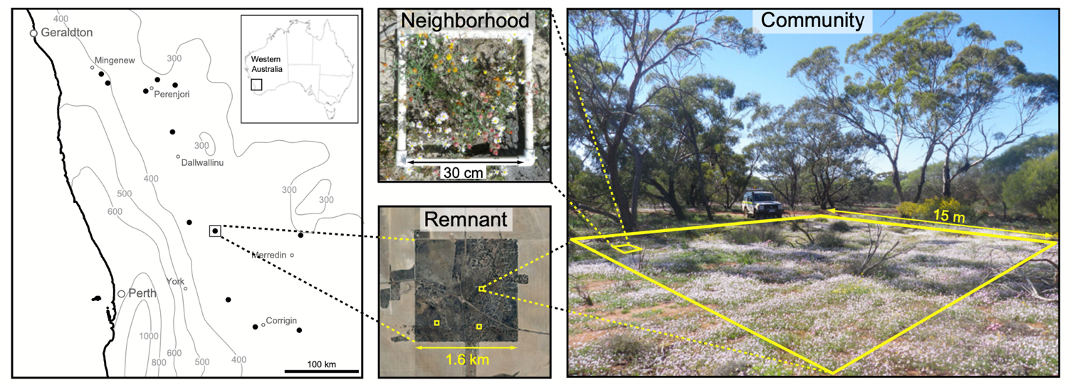
Designs with STRUCTURE
Dr John Dwyer CONS7008

Slide 2
Replication
The inclusion of many units (e.g. tigers, bottle trees, landscapes) within observational and experimental studies to ensure that a result:
was not exceptional (a one-off / fluke)
applies more broadly than to the specific subjects measured
Replication also increases statistical power (more on that later)

Slide 3
Independence
Definition: the treatment or response of one experimental unit does not affect the response of another unit
Lack of independence can arise for many reasons, such as:
repeated measures of sampling or experimental units
observations are correlated in time
observations are correlated in space
Observations on related individuals or species

Slide 4
Independence
Definition: the treatment or response of one experimental unit does not affect the response of another unit
Lack of independence can arise for many reasons, such as:
repeated measures of sampling or experimental units
observations are correlated in time
observations are correlated in space
Observations on related individuals or species
DATA WITH “STRUCTURE”

Slide 5
Classic example: Rodent oestrus!!!
Heffner et al. 1996 Ecology

Slide 6
Classic example: Rodent oestrus!!!
Hypothesis: a compound in the shoots of annual grasses is responsible for the onset of the reproductive season in female rodents that eat these grasses
Experimental design: 20 adult rodent females are housed in 20 cages in a lab room; 10 are fed food without the compound, 10 are fed food with the compound
What is the problem?

Slide 7
Classic example: Rodent oestrus!!!
Problem: oestrus can be induced in female rodents via airborne chemical cues released by other females already in oestrus

Slide 8
Now a less ratty (observational) example!!!

Slide 9
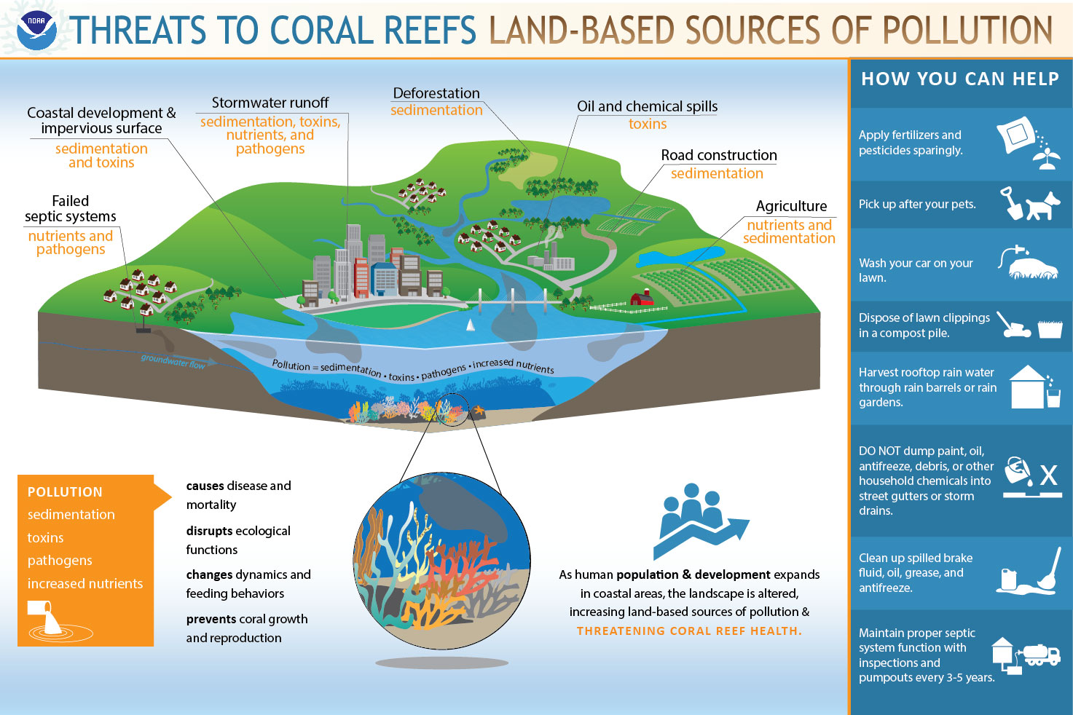

Slide 10
Land-based threats to coral reefs
Hypothesis: sedimentation negatively impacts coral health
Sampling design: measure coral health and sedimentation at 3 randomly chosen sites within 4 watersheds, two with high sediment loads and two with low sediment loads.

Slide 11
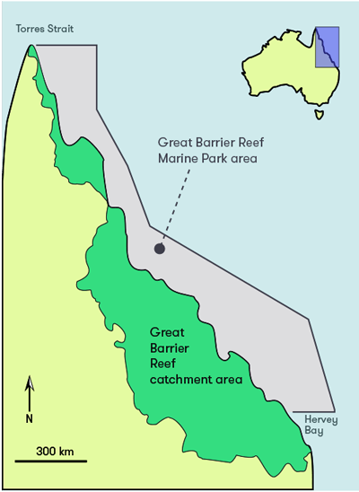

Any problem with this?
= low sed.
= high sed.

Slide 12
Land-based threats to coral reefs
Corals within watersheds are exposed to similar conditions, so not independent
This is PSEUDOREPLICATION!!!
If dependent data are analyzed as if they are independent, the sample size used is larger than the effective number of independent observations
Can result in too many significant results and lower estimated uncertainty (or higher precision) than is warranted

Slide 13
Land-based threats to coral reefs
Samples treated as dependent
high.sed <- rnorm(n = 2, mean = 10, sd = 1.5)
low.sed <- rnorm(n = 2, mean = 11.5, sd = 1.5)
t.test(high.sed, low.sed)
Run 5 times, p-values = 0.21, 0.15, 0.88, 0.11, 0.23
Samples treated as independent
high.sed <- rnorm(n = 6, mean = 10, sd = 1.5)
low.sed <- rnorm(n = 6, mean = 11.5, sd = 1.5)
t.test(high.sed, low.sed)
Run 5 times, p-values = 0.81, 0.52, 0.35, 0.19, <0.001

Slide 14
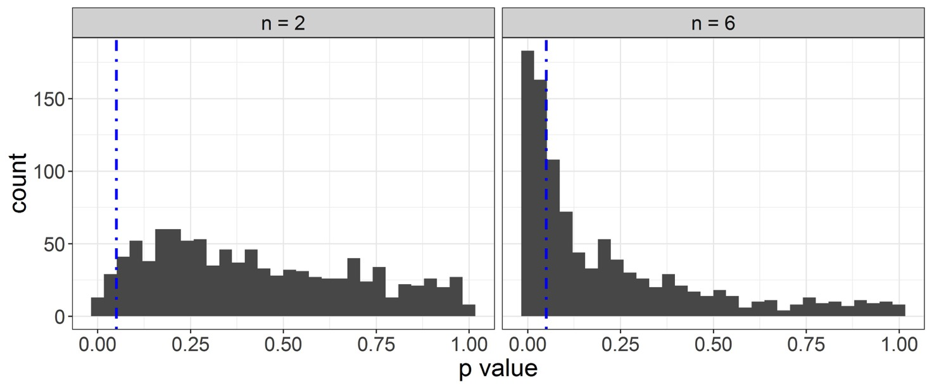
Land-based threats to coral reefs
Run 1000 times…
Samples recognized as dependent
Samples treated as independent

Slide 15
Context dependent designs often necessitate the use of “structure”!!!

Slide 16
Full factorial designs
Predictor variable 1
Ambient
Dry
Wet
Ambient + High Nutrients
Dry + High Nutrients
Wet + High Nutrients
High nutrients
Predictor variable 2
Ambient + Low Nutrients
Dry +
Low Nutrients
Wet + Low Nutrients
Low nutrients

Slide 17
Full factorial designs
Bench 1
Bench 2
Bench 3
Bench 4
Bench 5
Bench 6

Slide 18
Full factorial designs
Incorrectly ignoring bench “structure”
> factorial_lm<-lm(plant_biomass ~ water_treat + nutrient_treat +
water_treat: nutrient_treat, data = factorial_data)
Correctly including bench “structure”
> factorial_lmm<-lmer(plant_biomass ~ water_treat + nutrient_treat +
water_treat: nutrient_treat + (1|bench), data = factorial_data)

Slide 19
The lm() wrongly assumes this!

Slide 20
Split plot designs
Plot 1
Plot 2
Plot 3
Predictor 1
Nitrogen addition
Yes
No
Predictor 2
Species
A
B
Plot 4
Plot 5
Plot 6

Slide 21
Split plot designs
Incorrectly ignoring split plot “structure”
> split_plot_lm<-lm(wheat_biomass ~ nitrogen_treat + species +
nitrogen_treat:species, data = factorial_data)
Correctly including split plot “structure”
> split_plot_lmm<-lmer(wheat_biomass ~ nitrogen_treat + species +
nitrogen_treat:species + (1|plot/plot_half), data = factorial_data)

Slide 22
The lm() wrongly assumes this!
Predictor 1
Nitrogen addition
Predictor 2
Species
A
B

Slide 23
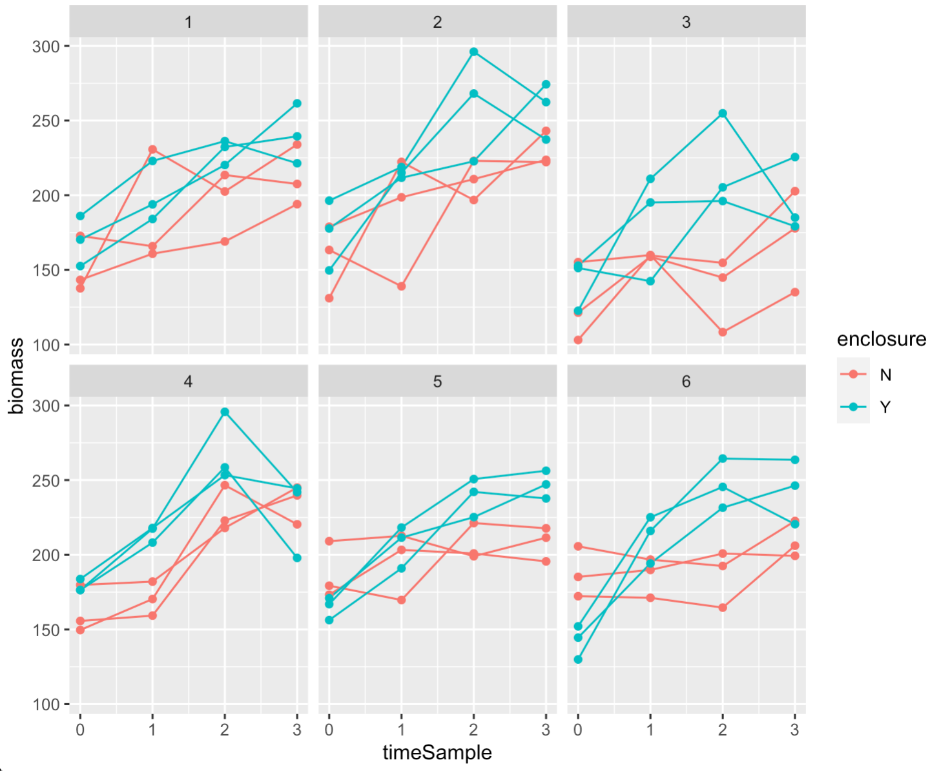
Repeated measures

Slide 24
Structure in observational studies

Slide 25
Structure in observational studies
Soil nutrients
Climate
variables
Average tree cover
Context dependence across SCALES!

Slide 26
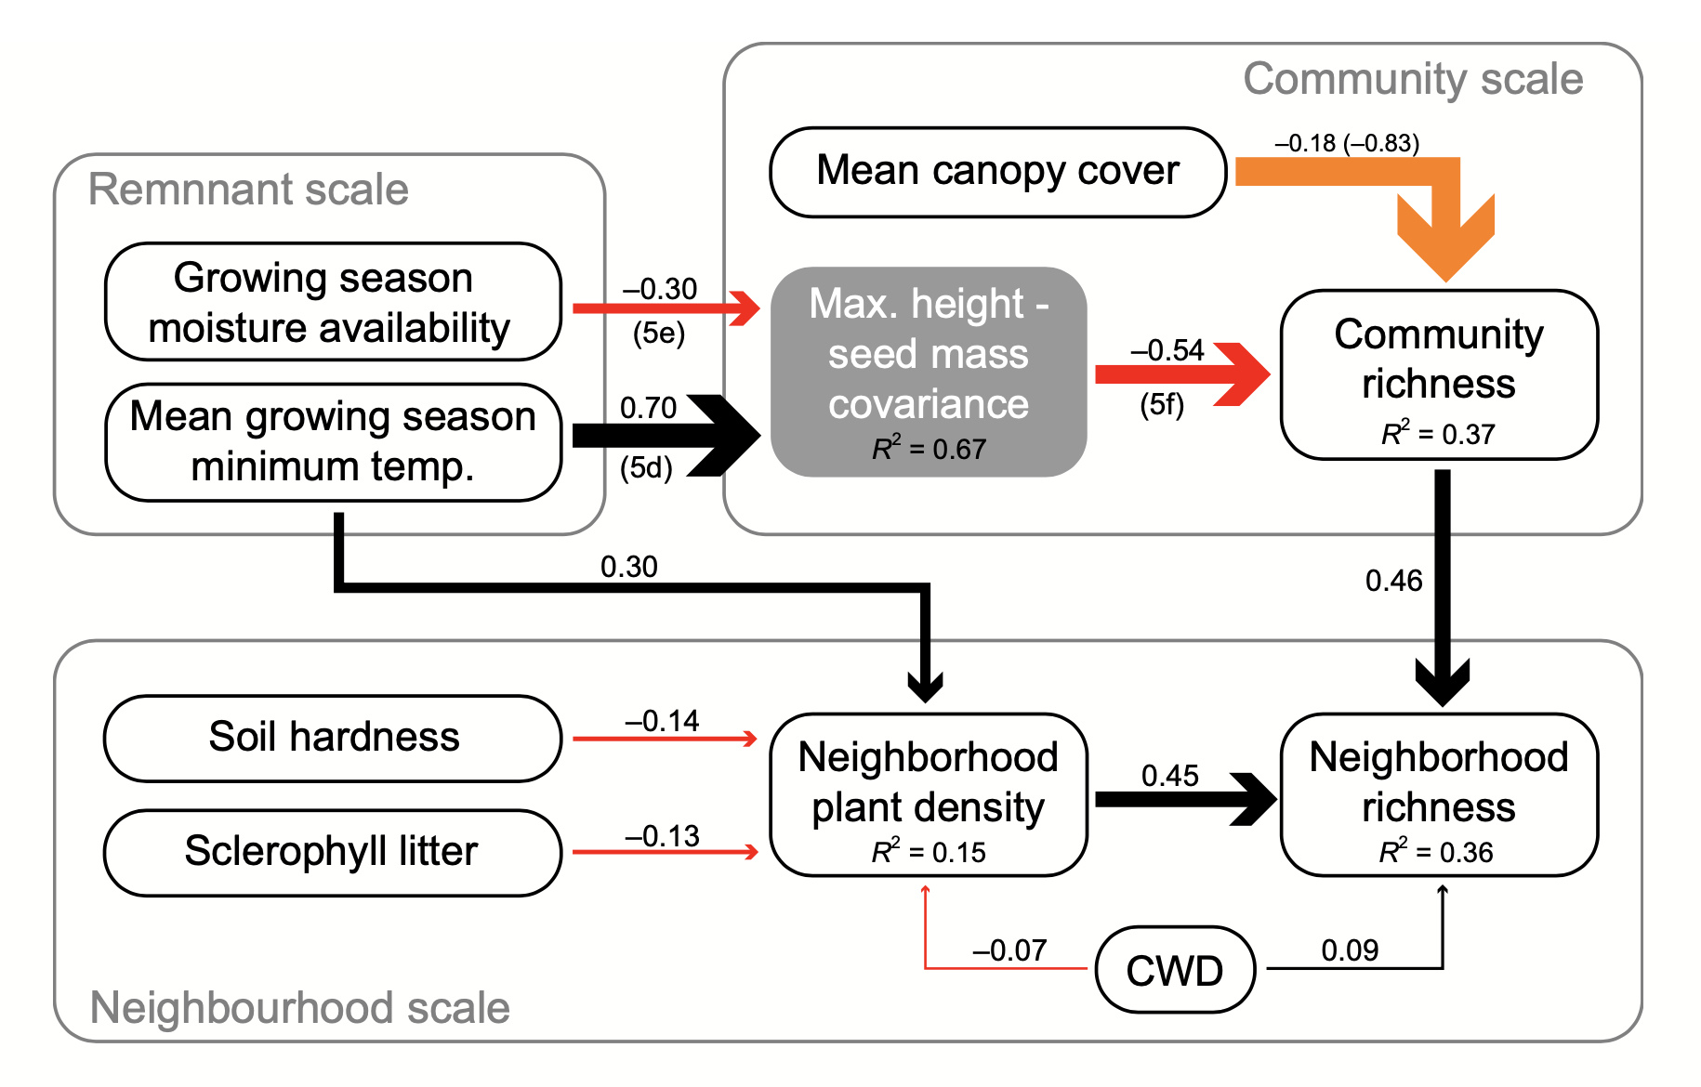
Structure in observational studies
Remnant scale

Slide 27
Key points
Lack of independence among sampling or experimental units is common!!!
Be ever mindful of PSEUDOREPLICATION!!!
When observations are grouped in space or time, this grouping needs to be acknowledged by using appropriate statistics (e.g. mixed-effects models)
Use data structure intelligently and it can actually be EXTREMELY INFORMATIVE!!!

Slide 28
Coming up
Thursday 1pm Workshop: Understanding fixed and random effects
Thursday 5pm Lecture (Rich Fuller): Socio-economic data II
Pre-recorded stats lecture: Mixed-effects models
Friday R Prac: Mixed-effects models

